Slide 1



A CENTER FOR INTER-DISCIPLINARY RESEARCH
2021-22
TITLE
“PREDICTION OF FOREST FIRES”
SUPERVISED BY
AMARAVADI BINDU
GOKARAJU RANGARAJU
INSTITUTE OF ENGINEERING AND TECHNOLOGY
AUTONOMOUS

Slide 2
Advanced Academic Center
( A Center For Inter-Disciplinary Research )
This is to certify that the project titled
“PREDICTION OF FOREST FIRES”
is a bonafide work carried out by the following students in partial fulfilment of the requirements for Advanced Academic Center intern, submitted to the chair, AAC during the academic year 2021-22.
NAME | ROLL NO | BRANCH
SUHANI SUNEHRA | 21241A0552 | CSE
KANDULA SAI MAHITH | 21241A04G1 | ECE
GANJI AKHIL CHANDRA | 21241A6686 | CSE-AIML
POTULA GANESH REDDY | 21241A05B4 | CSE
This work was not submitted or published earlier for any study
Dr/Ms./Mr.
Dr.B.R.K.Reddy
Program Coordinator
Dr.Ramamurthy Suri
Associate Dean,AAC
Project Supervisor

Slide 3
ACKNOWLEDGEMENTS
We express our deep sense of gratitude to our respected Director, Gokaraju Rangaraju Institute of Engineering and Technology, for the valuable guidance and for permitting us to carry out this project.
With immense pleasure, we extend our appreciation to our respected Principal, for permitting us to carry out this project.
We are thankful to the Associate Dean, Advanced Academic Centre, for providing us an appropriate environment required for the project completion.
We are grateful to our project supervisor who spared valuable time to influence us with their novel insights.
We are indebted to all the above mentioned people without whom we would not have concluded the project.

Slide 4
PREDICTION OF FOREST FIRES: 1. ABSTRACT 2. INTRODUCTION 3. PROJECT WORKFLOW 4. CODE 5. FUTURE DEVELOPMENTS 6. REFERENCES

Slide 5
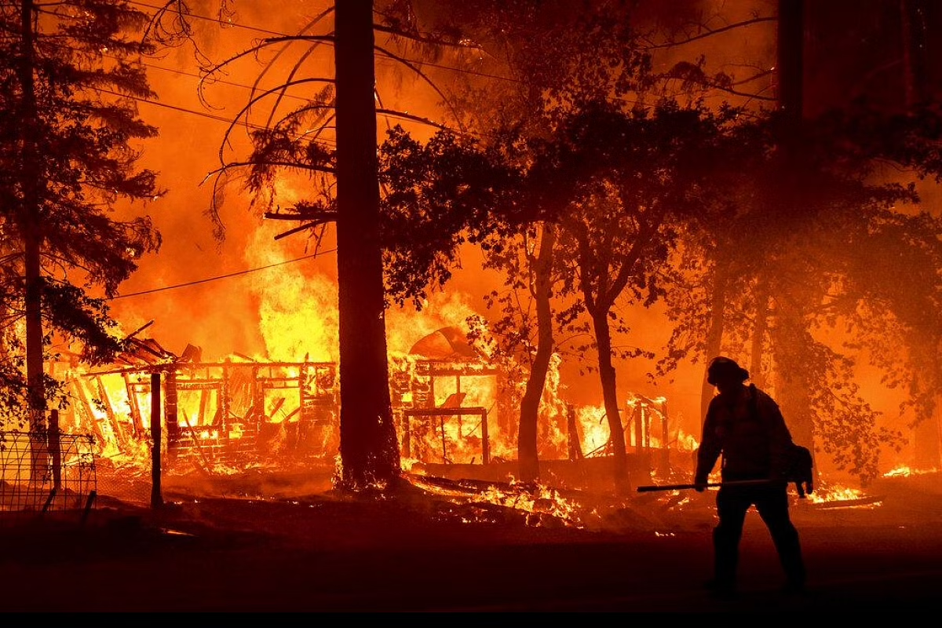
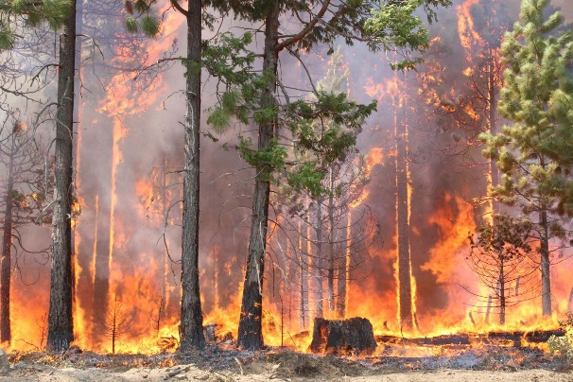
ABSTRACT Forest fires are a major environmental issue, creating economic and ecological damage as well as endangering human lives. Forest fires or wildfires are spontaneously occurring fires in forests, bushes and plains and can occasionally be controlled. Forest fire prediction constitutes a significant component of forest fire management. It plays a major role in resource allocation, mitigation and recovery efforts. There are several contributory attributes and parameters involved in the occurrence of a forest fire including latitude, longitude, spatial coordinates, and meteorological factors like temperature, relative humidity, wind, hours of sunlight, precipitation, etc. Dealing with multiple relationships between these factors that are responsible for the fire and predicting its occurrence and the area which is going to be affected by it requires extensive use of Machine Learning.

Slide 6

2.INTRODUCTION 2.1 WHAT IS ML Machine learning is a branch of artificial intelligence that allows machines to learn and develop without being explicitly programmed. Machine learning is concerned with the design of software programs that can acquire data and learn for themselves. Machine learning analyses data, interprets it, learns from it, and makes the best possible business decisions on the basis on the learnings using a set of learning algorithms (supervised or unsupervised learning algorithms). Machine learning experts employ statistical techniques and computer science concepts to enable machines to learn from current data and gradually improve without needing to be specifically trained to such a degree. SVM, K-means clustering, Nave Bayes, Linear Regression, Logistic Regression, Neural Networks, Ensemble Methods, and Decision Trees are examples of widely used machine learning algorithms.

Slide 7
2.2 HISTORY OF MACHINE LEARNING Machine learning history starts in 1943 with the first mathematical model of neural networks presented in the scientific paper "A logical calculus of the ideas immanent in nervous activity" by Walter Pitts and Warren McCulloch. Then, in 1949, the book The Organization of Behavior by Donald Hebb is published. The book had theories on how behavior relates to neural networks and brain activity and would go on to become one of the monumental pillars of machine learning development. In 1950 Alan Turing created the Turing Test to determine if a computer has real intelligence. To pass the test, a computer must be able to fool a human into believing it is also human. He presented the principle in his paper Computing Machinery and Intelligence while working at the University of Manchester. It opens with the words: “I propose to consider the question, ’Can machines think?’” The term machine learning was coined in 1959 by Arthur Samuel, an IBM employee and pioneer in the field of computer gaming and artificial intelligence. Also the synonym self-teaching computer were used in this time period. By the early 1960s an experimental "learning machine" with punched tape memory, called Cybertron , had been developed by Raytheon Company to analyze sonar signals, electrocardiograms and speech patterns using rudimentary reinforcement learning. It was repetitively "trained" by a human operator/teacher to recognize patterns and equipped with a "goof" button to cause it to re-evaluate incorrect decisions. A representative book on research into machine learning during the 1960s was Nilsson's book on Learning Machines, dealing mostly with machine learning for pattern classification. Interest related to pattern recognition continued into the 1970s, as described by Duda and Hart in 1973. In 1981 a report was given on using teaching strategies so that a neural network learns to recognize 40 characters (26 letters, 10 digits, and 4 special symbols) from a computer terminal. Tom M. Mitchell provided a widely quoted, more formal definition of the algorithms studied in the machine learning field: "A computer program is said to learn from experience E with respect to some class of tasks T and performance measure P if its performance at tasks in T, as measured by P, improves with experience E." This definition of the tasks in which machine learning is concerned offers a fundamentally operational definition rather than defining the field in cognitive terms. This follows Alan Turing's proposal in his paper "Computing Machinery and Intelligence", in which the question "Can machines think?" is replaced with the question "Can machines do what we (as thinking entities) can do?". Modern day machine learning has two objectives, one is to classify data based on models which have been developed, the other purpose is to make predictions for future outcomes based on these models. A hypothetical algorithm specific to classifying data may use computer vision of moles coupled with supervised learning in order to train it to classify the cancerous moles. A machine learning algorithm for stock trading may inform the trader of future potential predictions.

Slide 8
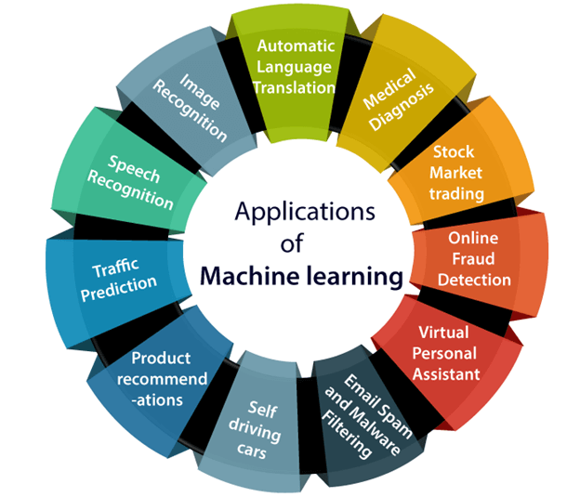
2.3 APPLICATIONS OF MACHINE LEARNING: 1. Image Recognition: Image recognition is one of the most common applications of machine learning. It is used to identify objects, persons, places, digital images, etc. 2. Speech Recognition: While using Google, we get an option of "Search by voice," it comes under speech recognition, and it's a popular application of machine learning. 3. Traffic prediction: If we want to visit a new place, we take help of Google Maps, which shows us the correct path with the shortest route and predicts the traffic conditions. 4. Product recommendations: Machine learning is widely used by various e-commerce and entertainment companies such as Amazon, Netflix, etc., for product recommendation to the user. Whenever we search for some product on Amazon, then we started getting an advertisement for the same product while internet surfing on the same browser and this is because of machine learning. 5. Self-driving cars: One of the most exciting applications of machine learning is self-driving cars. Machine learning plays a significant role in self-driving cars.

Slide 9
2.4 FOREST FIRES The most common hazard in forests is forests fire. Forests fires are as old as the forests themselves. They pose a threat not only to the forest wealth but also to the entire regime to fauna and flora seriously disturbing the bio-diversity and the ecology and environment of a region. During summer, when there is no rain for months, the forests become littered with dry senescent leaves and twinges, which could burst into flames ignited by the slightest spark. The Himalayan forests, particularly, Garhwal Himalayas have been burning regularly during the last few summers, with colossal loss of vegetation cover of that region. Forest fire causes imbalances in nature and endangers biodiversity by reducing faunal and floral wealth. Traditional methods of fire prevention are not proving effective and it is now essential to raise public awareness on the matter, particularly among those people who live clos to or in forested areas. Fires are a major cause of forest degradation and have wide ranging adverse ecological, economic and social impacts, including: 1.loss of valuable timber resources 2.degradation of catchment areas 3.loss of biodiversity and extinction of plants and animals 4.loss of wildlife habitat and depletion of wildlife 5.loss of natural regeneration and reduction in forest cover and global warming 6.loss of carbon sink resource and increase in percentage of CO2 in atmosphere 7.change in the microclimate of the area with unhealthy living conditions 8.soil erosion affecting productivity of soils and production 9.ozone layer depletion 10.health problems leading to diseases 11.loss of livelihood for tribal people and the rural poor, as approximately 300 million people are directly dependent upon collection of non-timber forest products from forest areas for their livelihood. 2.5 WHY MACHINE LEARNING? Well, the first question arises as that why we even need Machine learning to predict forest fire in that particular area? So, yes the question is valid that despite having the experienced forest department who have been dealing with these issues for a long time why is there a need for ML, having said that answer is quite simple that the experienced forest department can check on 3-4 parameters from their human mind but ML on other hand can handle the numerous parameters whether it can be latitude, longitude, satellite, version, and whatnot, so dealing with this multi-relationship of a parameter that is responsible for the fire in the forest we do need ML for sure!

Slide 10

2.6 ALGORITHMS USED LOGISTIC REGRESSION: 1.Logistic regression is one of the most popular Machine Learning algorithms, which comes under the Supervised Learning technique. It is used for predicting the categorical dependent variable using a given set of independent variables. 2.Logistic regression predicts the output of a categorical dependent variable. Therefore the outcome must be a categorical or discrete value. It can be either Yes or No, 0 or 1, true or False, etc. but instead of giving the exact value as 0 and 1, it gives the probabilistic values which lie between 0 and 1. 3.Logistic Regression is much similar to the Linear Regression except that how they are used. Linear Regression is used for solving Regression problems, whereas Logistic regression is used for solving the classification problems. 4.In Logistic regression, instead of fitting a regression line, we fit an "S" shaped logistic function, which predicts two maximum values (0 or 1). 5.The curve from the logistic function indicates the likelihood of something such as whether the cells are cancerous or not, a mouse is obese or not based on its weight, etc . 6.Logistic Regression is a significant machine learning algorithm because it has the ability to provide probabilities and classify new data using continuous and discrete datasets. 7.Logistic Regression can be used to classify the observations using different types of data and can easily determine the most effective variables used for the classification. The below image is showing the logistic function:

Slide 11

DECISION TREE CLASSIFICATION: Decision Tree is a Supervised learning technique that can be used for both classification and Regression problems, but mostly it is preferred for solving Classification problems. It is a tree-structured classifier, where internal nodes represent the features of a dataset, branches represent the decision rules and each leaf node represents the outcome. In a Decision tree, there are two nodes, which are the Decision Node and Leaf Node. Decision nodes are used to make any decision and have multiple branches, whereas Leaf nodes are the output of those decisions and do not contain any further branches. The decisions or the test are performed on the basis of features of the given dataset. It is a graphical representation for getting all the possible solutions to a problem/decision based on given conditions. It is called a decision tree because, similar to a tree, it starts with the root node, which expands on further branches and constructs a tree-like structure. In order to build a tree, we use the CART algorithm, which stands for Classification and Regression Tree algorithm. A decision tree simply asks a question, and based on the answer (Yes/No), it further split the tree into subtrees. Below diagram explains the general structure of a decision tree:

Slide 12
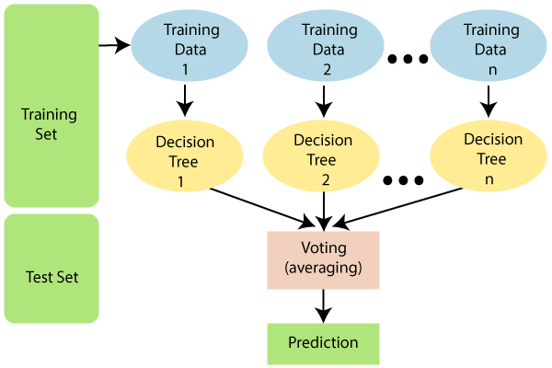
RANDOM FOREST CLASSIFIER: Random Forest is a popular machine learning algorithm that belongs to the supervised learning technique. It can be used for both Classification and Regression problems in ML. It is based on the concept of ensemble learning, which is a process of combining multiple classifiers to solve a complex problem and to improve the performance of the model. As the name suggests, "Random Forest is a classifier that contains a number of decision trees on various subsets of the given dataset and takes the average to improve the predictive accuracy of that dataset." Instead of relying on one decision tree, the random forest takes the prediction from each tree and based on the majority votes of predictions, and it predicts the final output. The greater number of trees in the forest leads to higher accuracy and prevents the problem of overfitting. Note: To better understand the Random Forest Algorithm, you should have knowledge of the Decision Tree Algorithm. The below diagram explains the working of the Random Forest algorithm:

Slide 13
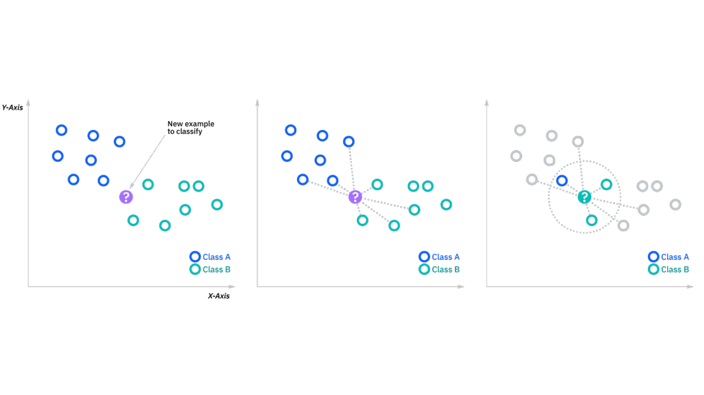
K NEAREST NEIGHBOURS CLASSIFIER:
The k-nearest neighbors algorithm, also known as KNN or k-NN, is a non-parametric, supervised learning classifier, which uses proximity to make classifications or predictions about the grouping of an individual data point. While it can be used for either regression or classification problems, it is typically used as a classification algorithm, working off the assumption that similar points can be found near one another.
Regression problems use a similar concept as classification problem, but in this case, the average the k nearest neighbors is taken to make a prediction about a classification. The main distinction here is that classification is used for discrete values, whereas regression is used with continuous ones. However, before a classification can be made, the distance must be defined. Euclidean distance is most commonly used.
The k value in the k-NN algorithm defines how many neighbors will be checked to determine the classification of a specific query point. For example, if k=1, the instance will be assigned to the same class as its single nearest neighbor. Defining k can be a balancing act as different values can lead to overfitting or underfitting. Lower values of k can have high variance, but low bias, and larger values of k may lead to high bias and lower variance. The choice of k will largely depend on the input data as data with more outliers or noise will likely perform better with higher values of k.
Applications of KNN in machine learning :-
→ Data Preprocessing
→Recommendation Engines
→Finance
→Healthcare
→Pattern Recognisation

Slide 14
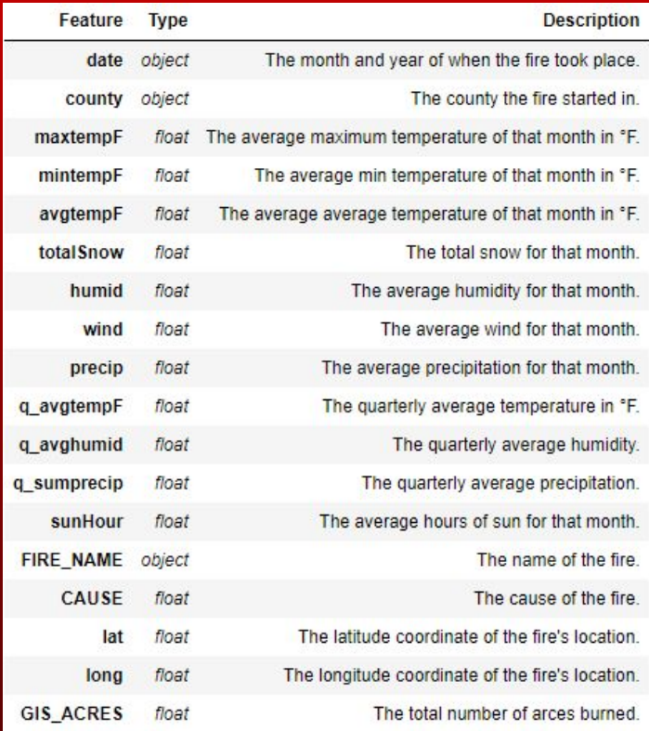
3. Project Workflow 3.1 Data collection: The dataset taken for this project has been collected from multiple public data repositories with data for wildfires that occurred in the state of California in USA. This dataset has columns representing several meteororlogical factors that have a significant effect on the occurrence of a wildfire. Dataset Description:
3.2 Data Preprocessing:
The data collected as a csv file is then transformed into a standard format. Any existing null values in the dataset were removed. This was done using the Pandas DataFrame for data manipulation, the pandas library in python. Columns like County FIRE_NAME, latitude and longitude which were unnecessary were dropped from the dataset and the dataset was split.

Slide 15
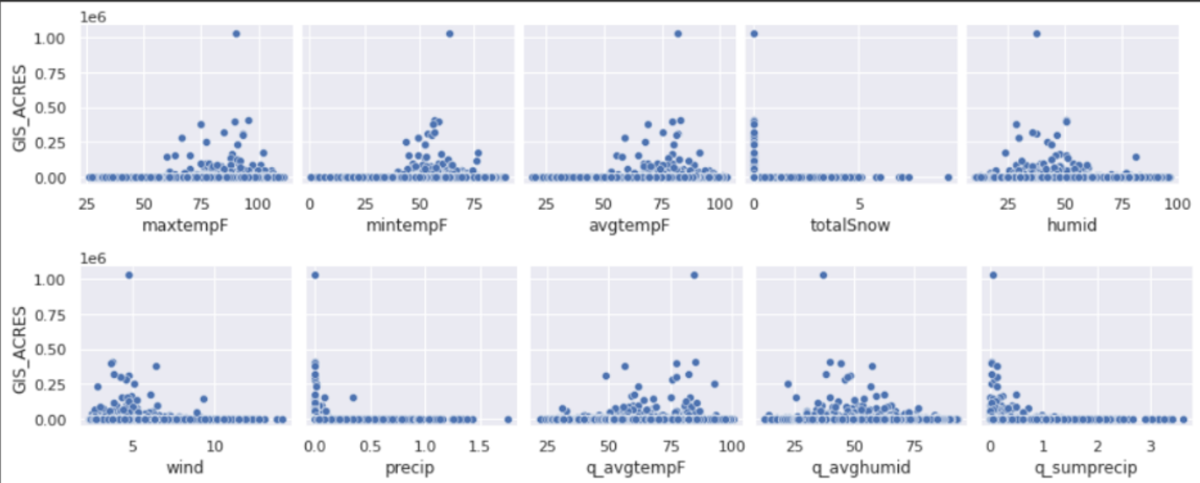
3.3 Data Visualisation: The data was plotted into multiple graphs to understand the correlation between the features and the output variable, area of the wildfire.
.
These graphs were obtained using the matplotlib and pyprophet libraries, which aid in data visualisation. Numpy was used for identification of null rows and values in the dataset for their removal. From these graphs, it is clear that temperature, humidity and wind play a major role in the occurrence of a wildfire.
The machine learning models used in this supervised machine learning project were obtained from the scikit learn library in python. It is an opensource machine learning library which provides simple and efficient tools for predictive data analysis. It consists of multiple classification, regression and clustering algorithms including support-vector machines, random forests, gradient boosting, k-means and DBSCAN, and is designed to interoperate with the Python numerical and scientific libraries NumPy and SciPy.
3.4 Splitting the dataset for model training: The dataset was split into test and train parts using train_test_split and the models were trained. 70% of the data was used to train the models while 30% was used for testing. The machine learning models used in this project are KNN Classifier, Logistic Regression and Random Forest Classifier.

Slide 16
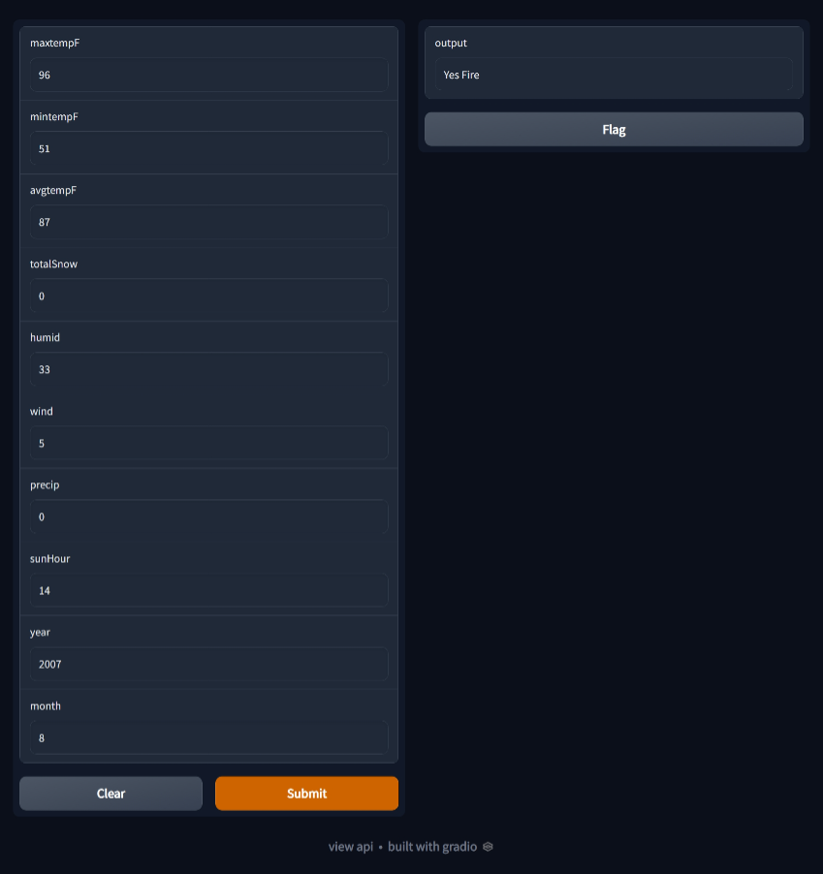
3.5 Results of the Algorithms: The accuracy for these models is as follows:
Model | R2 Score
KNN Classifier | 0.8571
Random Forest Classifier | 0.8938
Logistic Regression | 0.7538
We saw the highest accuracy for the Random Forest Classifier – 89%. We see that factors like average temperature, number of hours of sunlight, humidity and wind speed affected the wildfires significantly more than the other features in the dataset.
3.6 Creating an Interface
We used the gradio library in python in order to create an interactive interface where users can input values for meteorological features and get an output indicating if there is going to be a fire or not. We used the Random Forest Classifier model that was trained and gave inputs to it.
This interface was a web application.

Slide 17
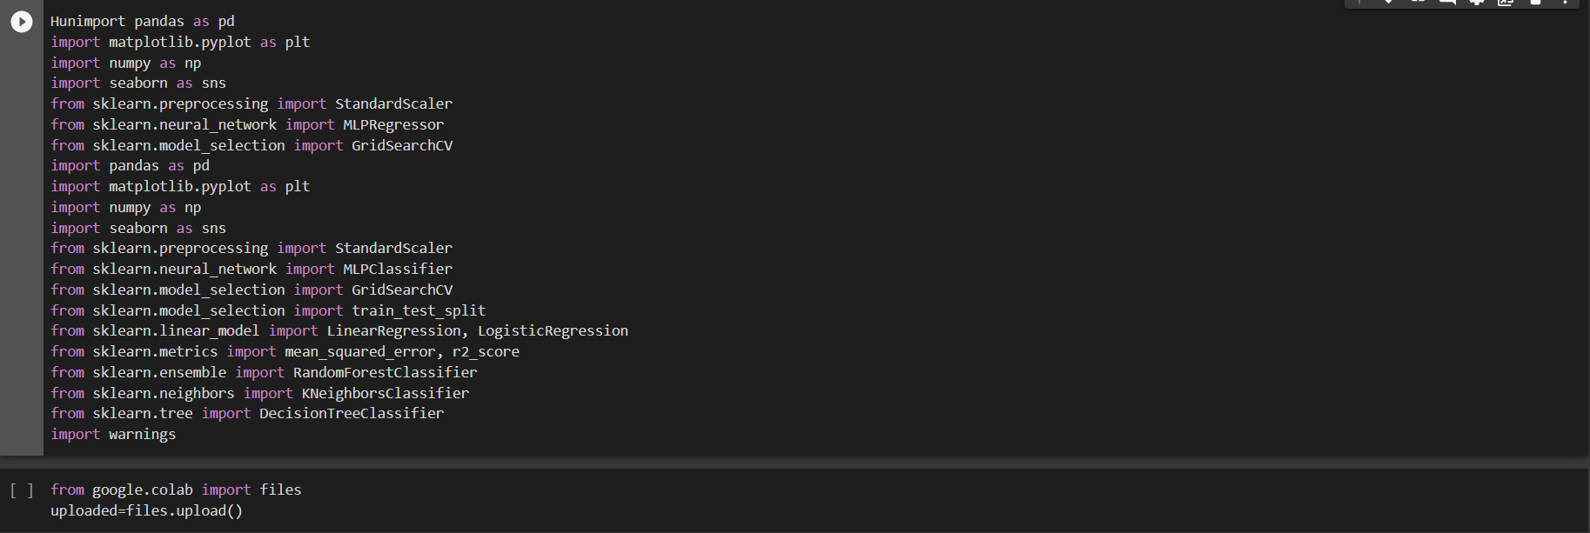
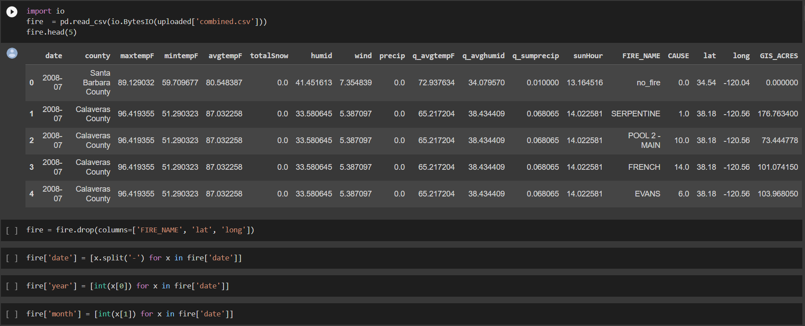
4. CODE: COLLECTING THE DATASET AND PREPROCESSING: Import all the required libraries:

Slide 18
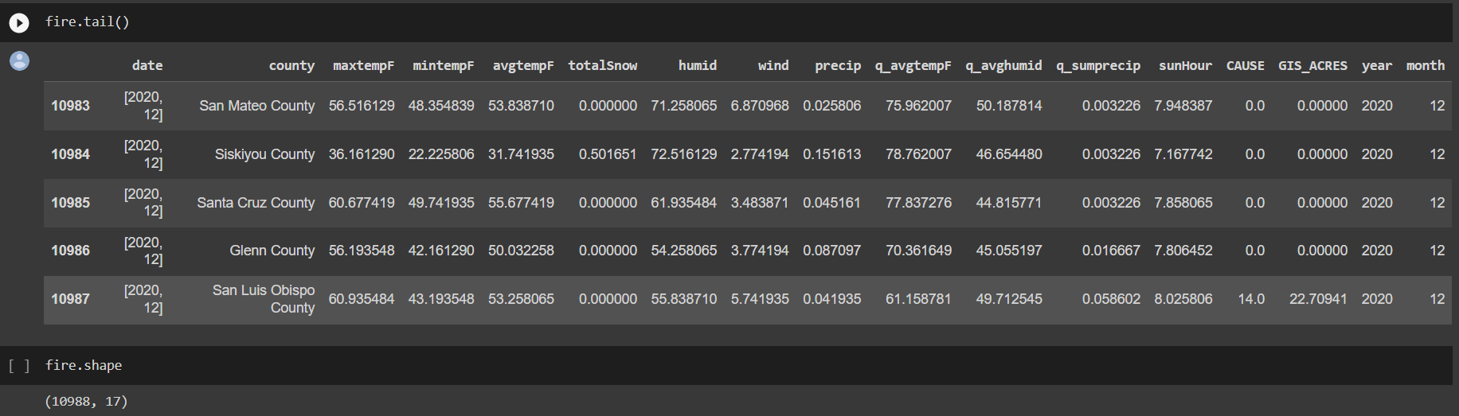
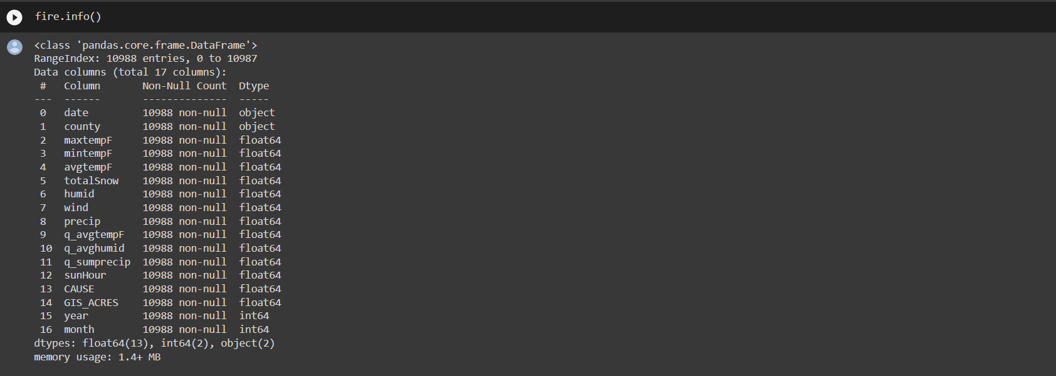
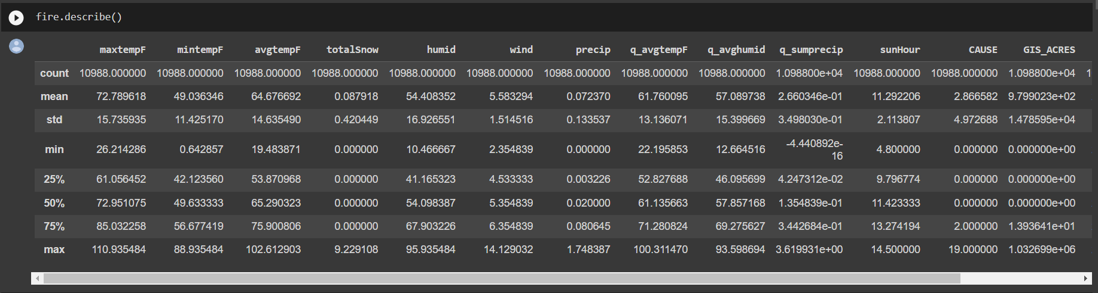

Slide 19
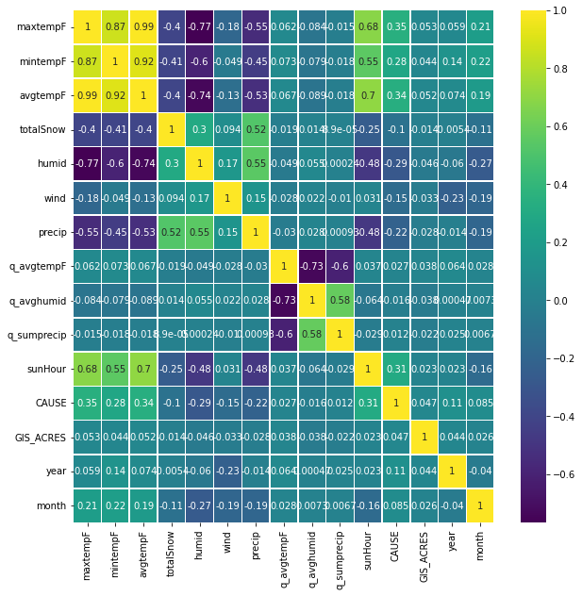
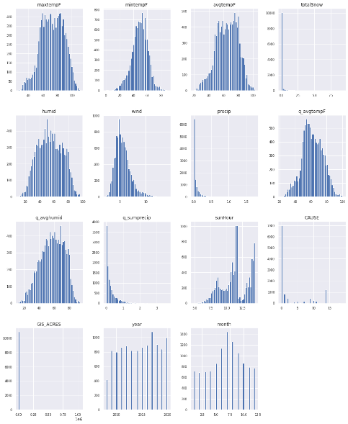
DATA VISUALIZATION: EXPLORATORY GRAPHS

Slide 20
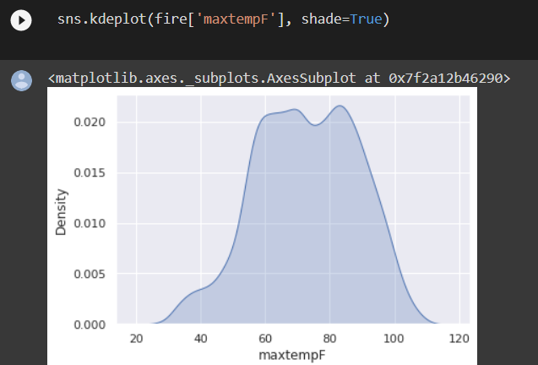
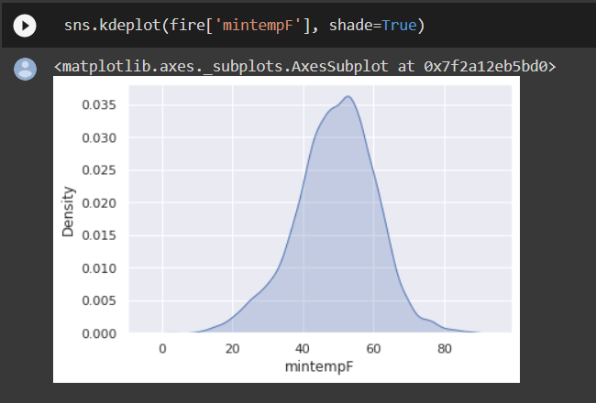
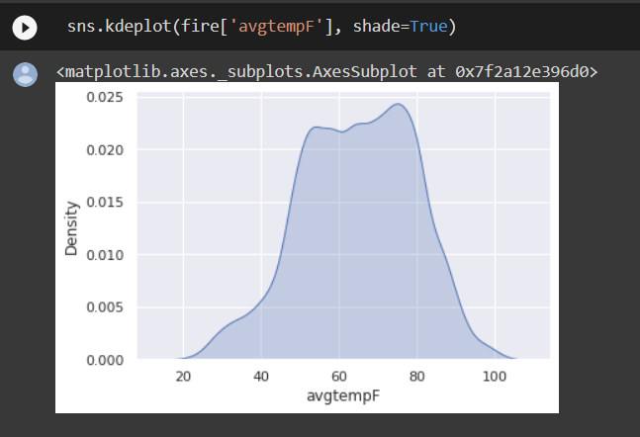
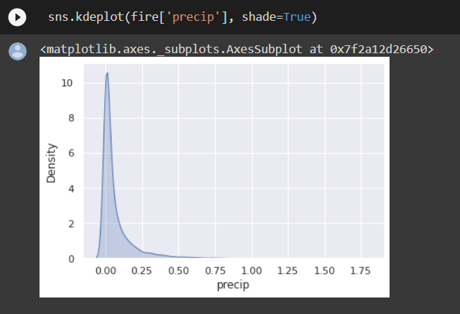
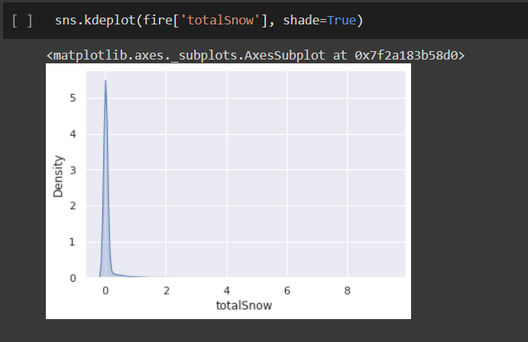
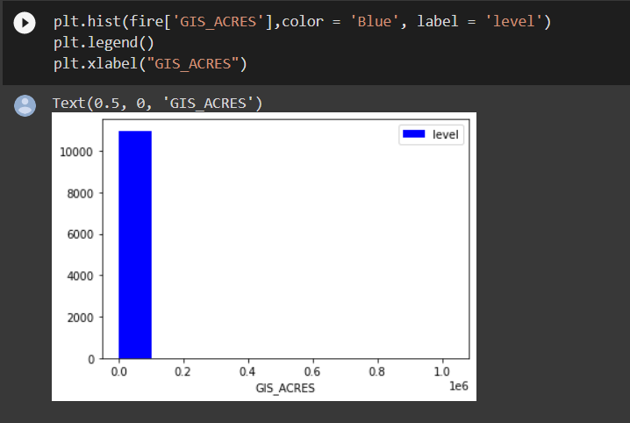
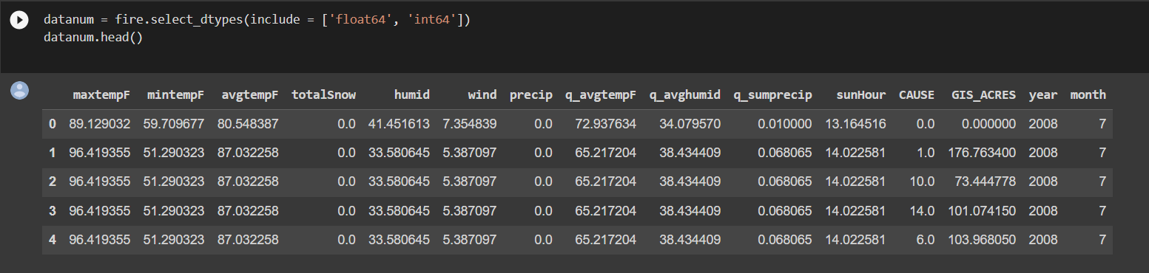
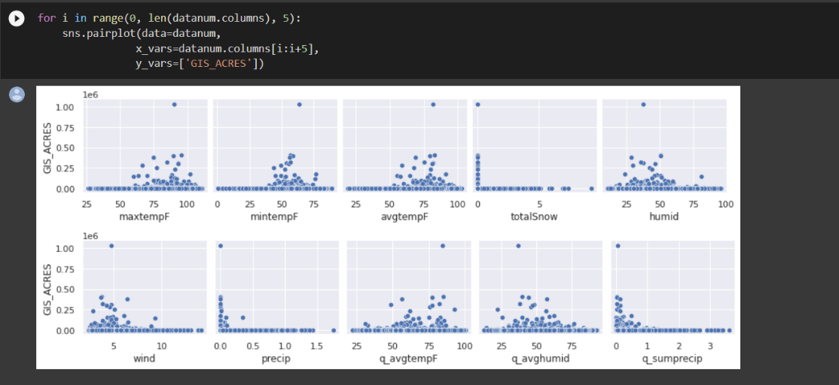

Slide 21
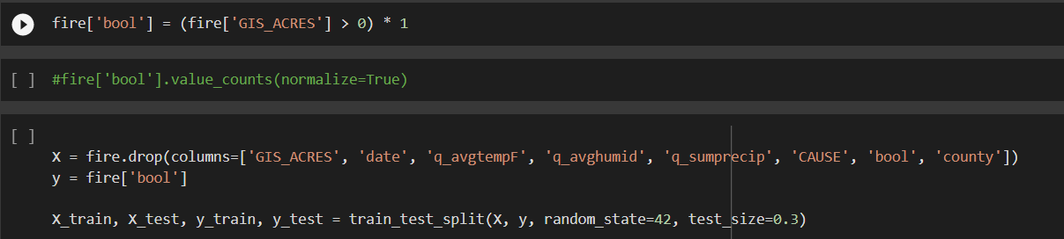
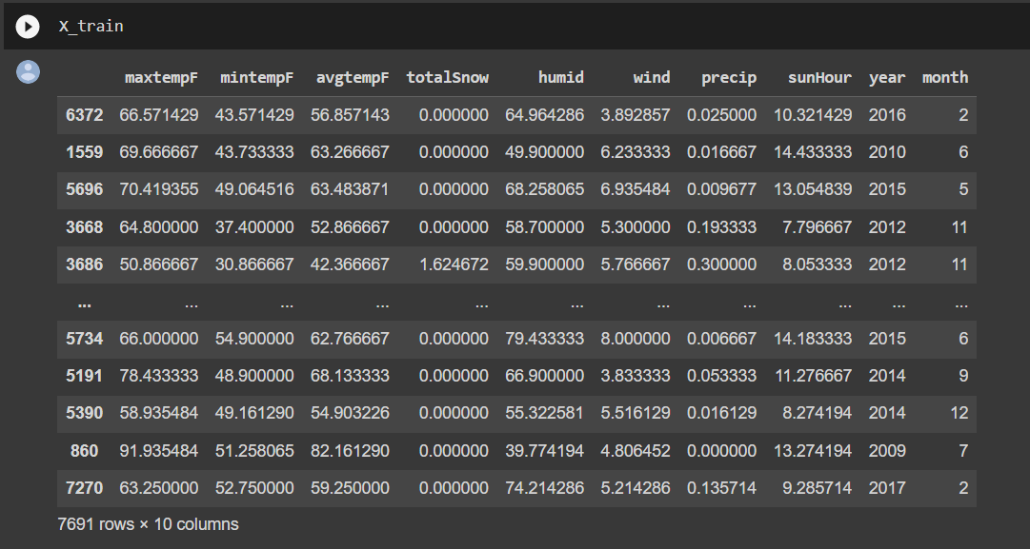
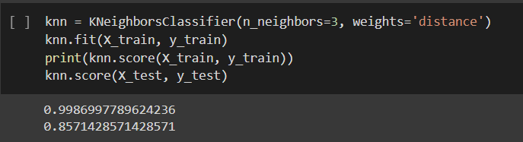
SPLITTING THE DATSET:
ALGORITHMS: OUTPUT AND ACCURACY:
KNN CLASSIFIER:

Slide 22
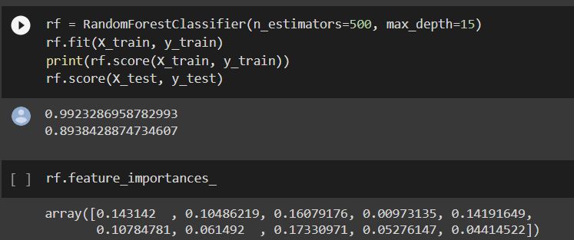
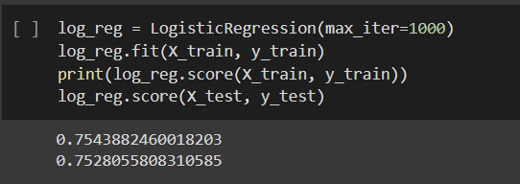
ALGORITHMS AND OUTPUT: RANDOM FOREST:
LOGISTIC REGESSION:

Slide 23
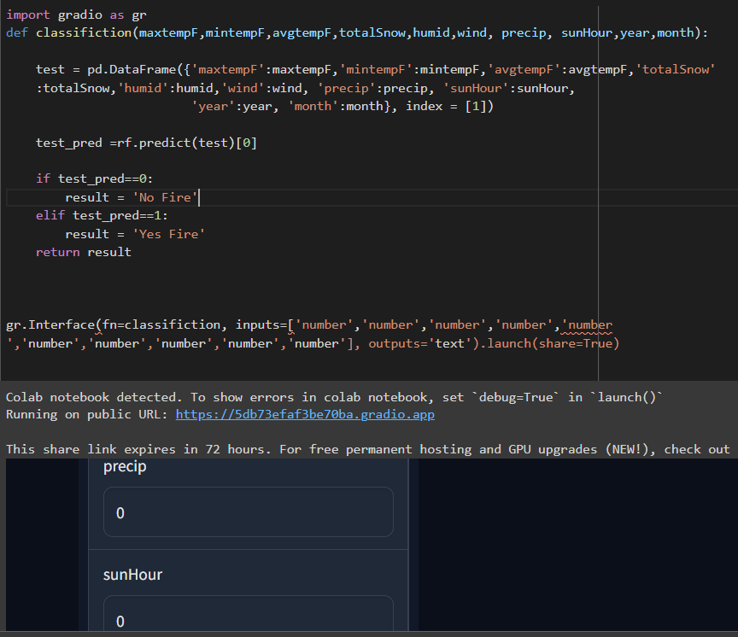
5. FUTURE DEVELOPMENTS: Machine Learning (ML) is so versatile and powerful that it’s one of the most exciting technologies of our times. Machine learning works on the principles of computer algorithms that learn in a reflex manner through trials and experiences. ML is an application of Artificial Intelligence that permits program applications to anticipate results with utmost precision. It makes a distinction to create computer programs and to assist computers to memorize without human intercession. As new technologies continue to unfold, machine learning algorithms can be used more productively. The future of ML clearly indicates the increased application of machine learning across various industry verticals. Gartner predicts that by 2022, 75% of new end-user solutions leveraging AI and ML techniques will be built with commercials instead of open-source platforms. The future of machine learning will open multiple opportunities for businesses. The machine learning revolution will stay with us for a long time and so will be the future of machine learning. Make sure that your business is ready to make the most of what is coming.
Interface: Gradio Web App:

Slide 24
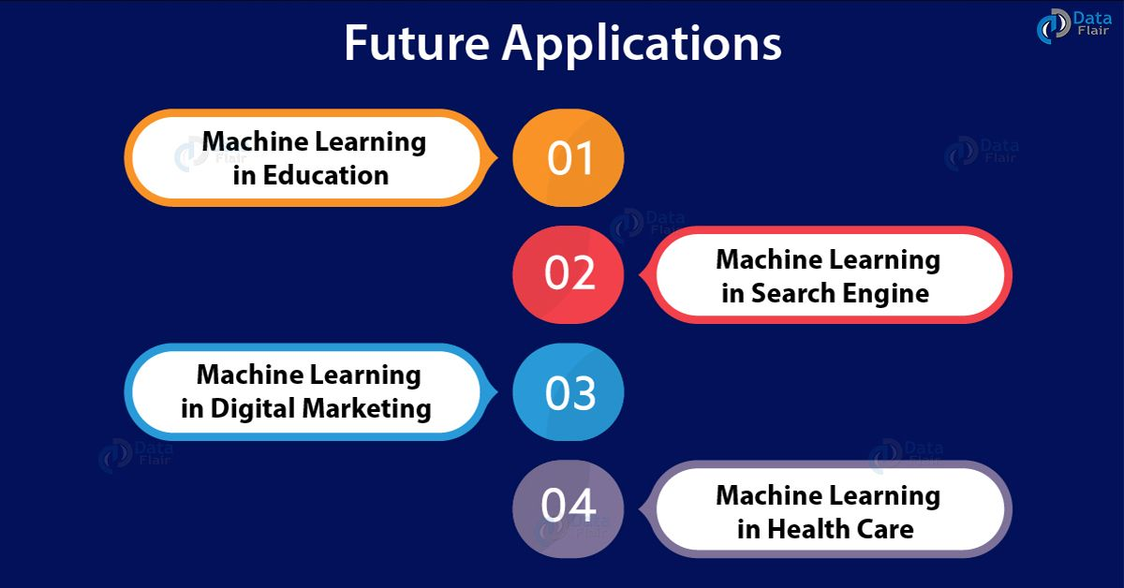
Future Developments in this Project:
This supervised machine learning project was done on historical data collected from existing public repositories like Calfire and GIS. However, using APIs, it is also possible to input live data into the project and get instantaneous alerts for wildfires.
A real-time application programming interface (API) is a service that enables users to automatically obtain information in real-time from one or more data resources. It can be embedded in a software application or added to a website.
This project can also be integrated with IoT: Internet of Things. We can employ the use of temperature, pressure and humidity sensors placed at a particular area and connect this system to our machine learning models. They can analyze data and predict the occurrence of a forest fire. If the values of temperature or pressure get abnormal or outlie the general range, we can get alerts.

Slide 25
6. References
https://www.javatpoint.com/machine-learning-random-forest-algorithm https://www.javatpoint.com/machine-learning-decision-tree-classification-algorithm https://www.javatpoint.com/linear-regression-in-machine-learning https://www.javatpoint.com/logistic-regression-in-machine-learning https://www.techtarget.com/whatis/A-Timeline-of-Machine-Learning-History#:~:text=The%20History%20and%20Future%20of,decision%20making%20in%20human%20cognition. https://www.dataversity.net/a-brief-history-of-machine-learning/ https://data-flair.training/blogs/future-of-machine-learning/ https://www.day1tech.com/what-does-the-future-of-machine-learning-look-like-2022-and-beyond/ Project by Kushal Topnani – AI BASED WILDFIRE PREDICTION - California State University, Sacramento (https://csu-csus.esploro.exlibrisgroup.com/esploro/outputs/graduate/AI-Based-Wildfire-Prediction/99257927863201671?institution=01CALS_USL)
https://github.com/osyounis/cali_wildfire_likelihood_predictor

